Slide 1
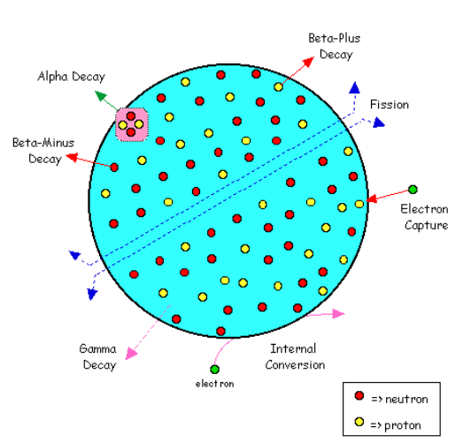

Slide 2
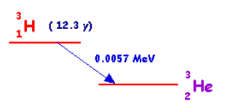
Decay Schemes
Decay schemes are widely used to give a visual representation of radioactive decay.
A scheme for a relatively straight-forward decay is shown below:
This scheme is for hydrogen-3 which decays to helium-3 with a half-life of 12.3 years through the emission of a beta-minus particle with an energy of 0.0057 MeV

Slide 3
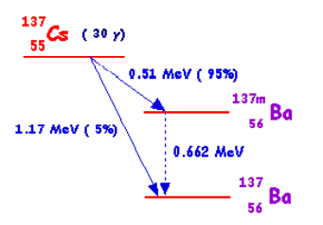
A scheme for a more complicated decay is that of caesium-137:
This isotope can decay through through two beta-minus processes.
In one which occurs in 5% of disintegrations a beta-minus particle is emitted with an energy of 1.17 MeV to produce barium-137.

Slide 4
A scheme for a more complicated decay is that of caesium-137:
In the second which occurs more frequently (in the remaining 95% of disintegrations) a beta-minus particle of energy 0.51 MeV is emitted to produce barium-137m - in other words a barium-137 nucleus in a metastable state.
The barium-137m then decays via isomeric transition with the emission of a gamma-ray of energy 0.662 MeV.

Slide 5
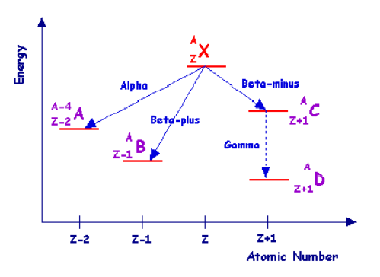
The general method used for decay schemes is illustrated in the diagram
The energy is plotted on the vertical axis and atomic number on the horizontal axis - although these axes are rarely displayed in actual schemes.
The isotope from which the scheme originates is displayed at the top - X in the case above.
This isotope is referred to as the parent.

Slide 6
The general method used for decay schemes is illustrated in the diagram
The parent looses energy when it decays and hence the products of the decay referred to as daughters are plotted at a lower energy level.
The diagram illustrates the situation for common forms of radioactive decay

Slide 7
The general method used for decay schemes is illustrated in the diagram
Alpha-decay is illustrated on the left where the mass number is reduced by 4 and the atomic number is reduced by 2 to produce daughter A.
To its right the scheme for beta-plus decay is shown to produce daughter B.
The situation for beta-minus decay followed by gamma-decay is shown on the right side of the diagram where daughters C and D respectively are produced.

Slide 8
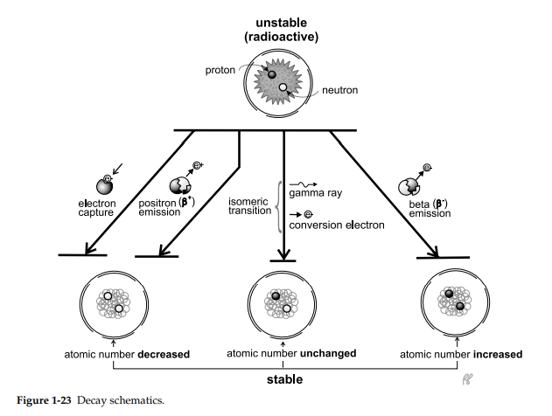

Slide 9
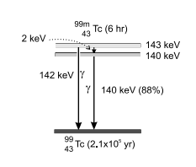
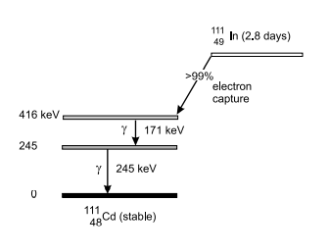

Slide 10
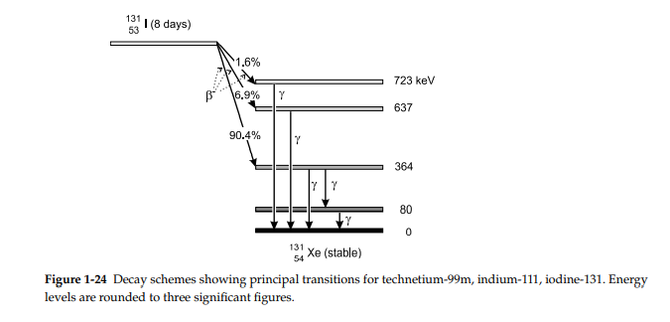

Slide 11
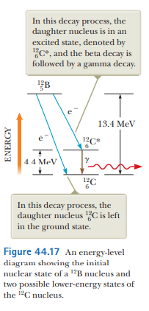

Slide 12
